Slide 1
Some basic knowledge
Posts and Telecommunication Institute of Technology
Faculty of Information Technology 1
Mathematic discrete1
Ngo Xuan Bach
Dao Thi Thuy Quynh

Slide 2
Contents
Set theory
Propositional logic
Algorithms and complexity
Exercise

Slide 3
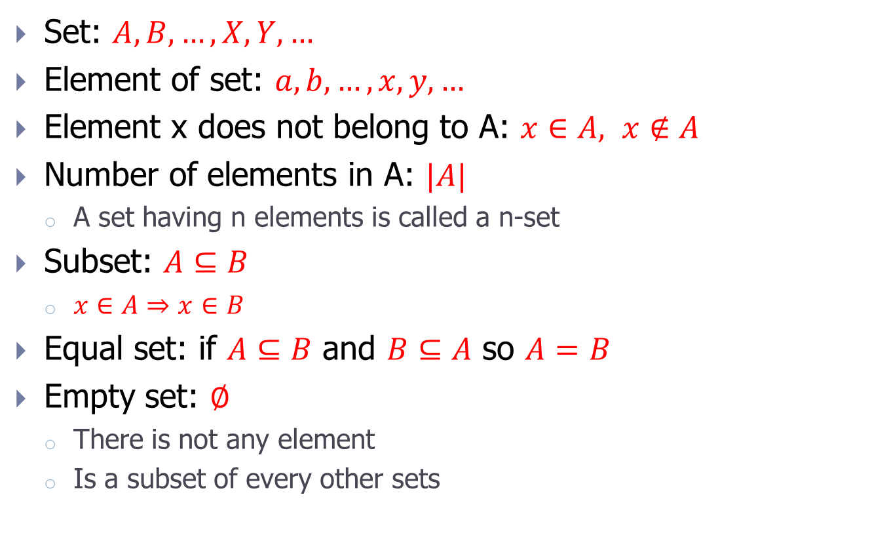
Mathematical notation
Set: $A, B, …, X, Y,…$
Element of set: $a, b, …, x, y, …$
Element x does not belong to A: $x∈A, x∉A$
Number of elements in A: $|A|$
A set having n elements is called a n-set
Subset: $A⊆B$
$x∈A⇒x$ $∈B$
Equal set: if $A⊆B$ and $B⊆A$ so $A=B$
Empty set: $∅$
There is not any element
Is a subset of every other sets

Slide 4

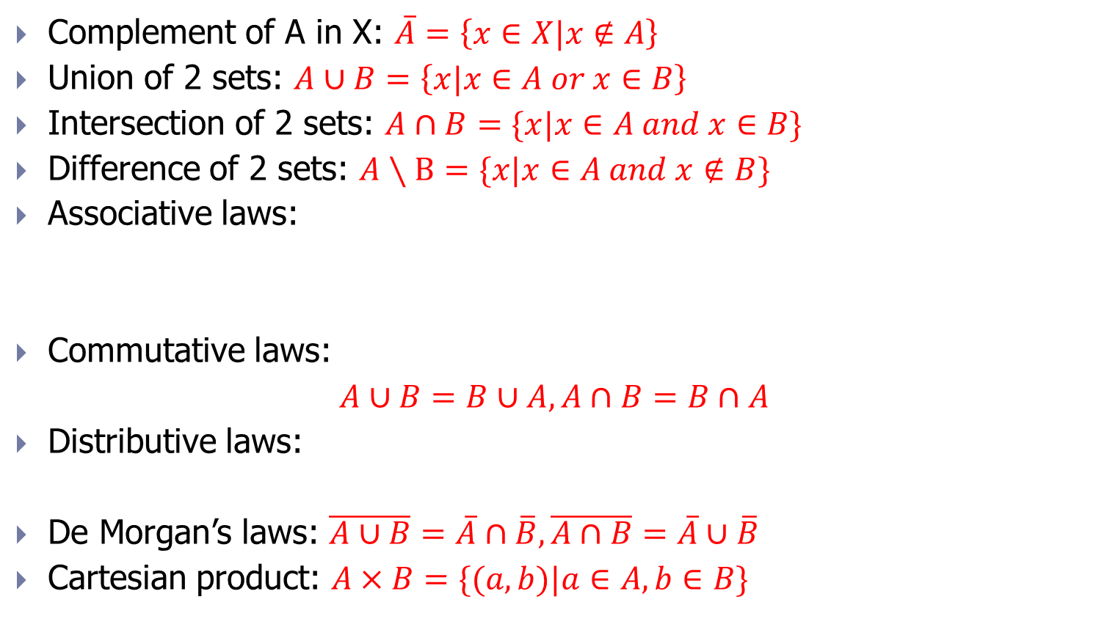
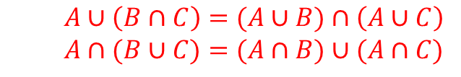
Set operators
Complement of A in X: $\overline{A}=\left\{x∈X|x∉A\right\}$
Union of 2 sets: $A∪B=\left\{x|x∈A or x∈B\right\}$
Intersection of 2 sets: $A∩B=\{x|x∈A and x∈B\}$
Difference of 2 sets: $A∖B=\{x|x∈A and x∉B\}$
Associative laws:
Commutative laws:
$A∪B=B∪A, A∩B=B∩A$
Distributive laws:
De Morgan’s laws: $\overline{A∪B}=\overline{A}∩\overline{B}, \overline{A∩B}=\overline{A}∪\overline{B}$
Cartesian product: $A×B=\{(a,b)|a∈A,b∈B\}$
$$\left(A∪B\right)∪C=A∪\left(B∪C\right)$$
$$\left(A∩B\right)∩C=A∩\left(B∩C\right)$$
$$A∪\left(B∩C\right)=(A∪B)∩\left(A∪C\right)$$
$$A∩(B∪C)=(A∩B)∪(A∩C)$$

Slide 5
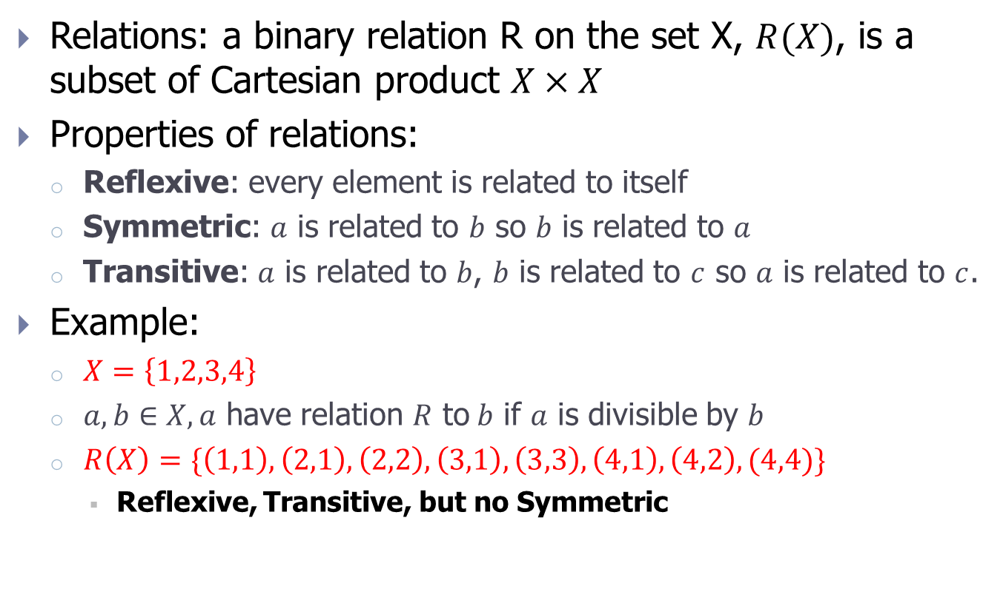
Relations
Relations: a binary relation R on the set X, $R(X)$, is a subset of Cartesian product $X×X$
Properties of relations:
Reflexive: every element is related to itself
Symmetric: $a$ is related to $b$ so $b$ is related to $a$
Transitive: $a$ is related to $b$, $b$ is related to $c$ so $a$ is related to $c$.
Example:
$X=\left\{1,2,3,4\right\}$
$a,b∈X, a$ have relation $R$ to$b$ if $a$ is divisible by $b$
$R\left(X\right)=\{\left(1,1\right),\left(2,1\right),\left(2,2\right),\left(3,1\right),\left(3,3\right),\left(4,1\right),\left(4,2\right), (4,4)\}$
Reflexive, Transitive, but no Symmetric

Slide 6
Equivalence relation and partition
Equivalence relation: a relation with full of 3 properties: reflexive, symmetric, and transitive
Equivalence class: is an equivalence relation partitions its set into equivalence classes
2 elements belonging to the same class are related
2 elements of different classes have no relation to each other
Equivalence classes cover the original set
Partition: is a family of equivalence classes (non-empty subsets) of a set
An equivalence relation on the set will define a partition on the set, otherwise any partition on the set will correspond to an equivalence relation on it.

Slide 7
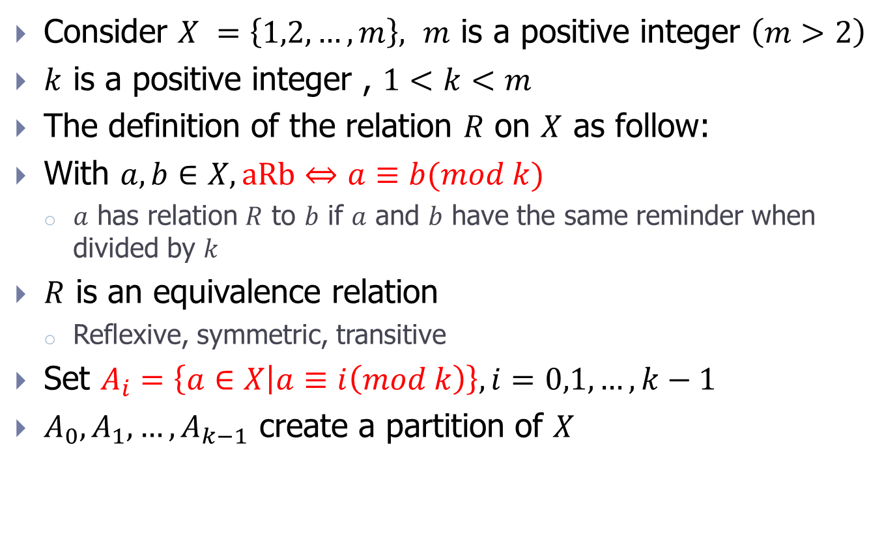
Example of equivalence relation
Consider $X =\left\{1,2,…,m\right\},$ $m$ is a positive integer $\left(m>2\right)$
$k$ is a positive integer , $1<k<m$
The definition of the relation $R$ on $X$ as follow:
With $a,b∈X, aRb⇔a≡b(mod k)$
$a$ has relation $R$ to $b$ if $a$ and $b$ have the same reminder when divided by $k$
$R$ is an equivalence relation
Reflexive, symmetric, transitive
Set $A_{i}=\left\{a∈X | a≡i\left(mod k\right)\right\}, i=0,1,…,k−1$
$A_{0},A_{1}, …,A_{k−1}$ create a partition of $X$

Slide 8
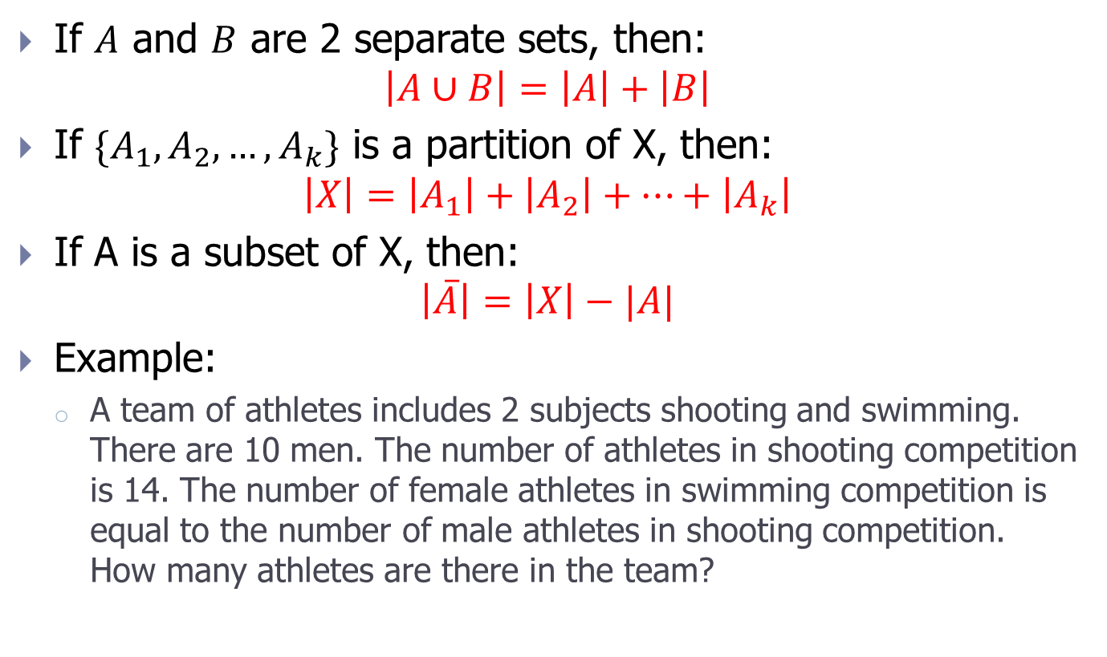
Addition principle
If $A$ and $B$ are 2 separate sets, then:
$$\left|A∪B\right|=\left|A\right|+\left|B\right|$$
If ${\{A}_{1},A_{2}, …,A_{k}\}$ is a partition of X, then:
$$\left|X\right|=\left|A_{1}\right|+\left|A_{2}\right|+…+\left|A_{k}\right|$$
If A is a subset of X, then:
$$\left|\overline{A}\right|=\left|X\right|−|A|$$
Example:
A team of athletes includes 2 subjects shooting and swimming. There are 10 men. The number of athletes in shooting competition is 14. The number of female athletes in swimming competition is equal to the number of male athletes in shooting competition. How many athletes are there in the team?

Slide 9
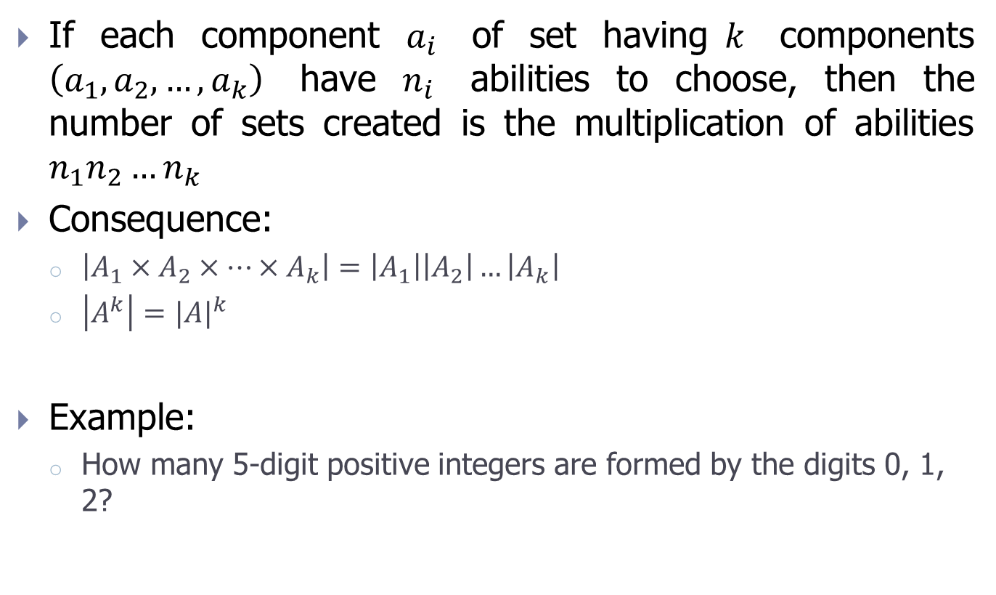
Multiplication principle
If each component $a_{i}$ of set having$k$ components $\left(a_{1},a_{2},…,a_{k}\right)$ have $n_{i}$ abilities to choose, then the number of sets created is the multiplication of abilities $n_{1}n_{2}…n_{k}$
Consequence:
$\left|A_{1}×A_{2}×…×A_{k}\right|=\left|A_{1}\right|\left|A_{2}\right|…\left|A_{k}\right|$
$\left|A^{k}\right|={|A|}^{k}$
Example:
How many 5-digit positive integers are formed by the digits 0, 1, 2?

Slide 10
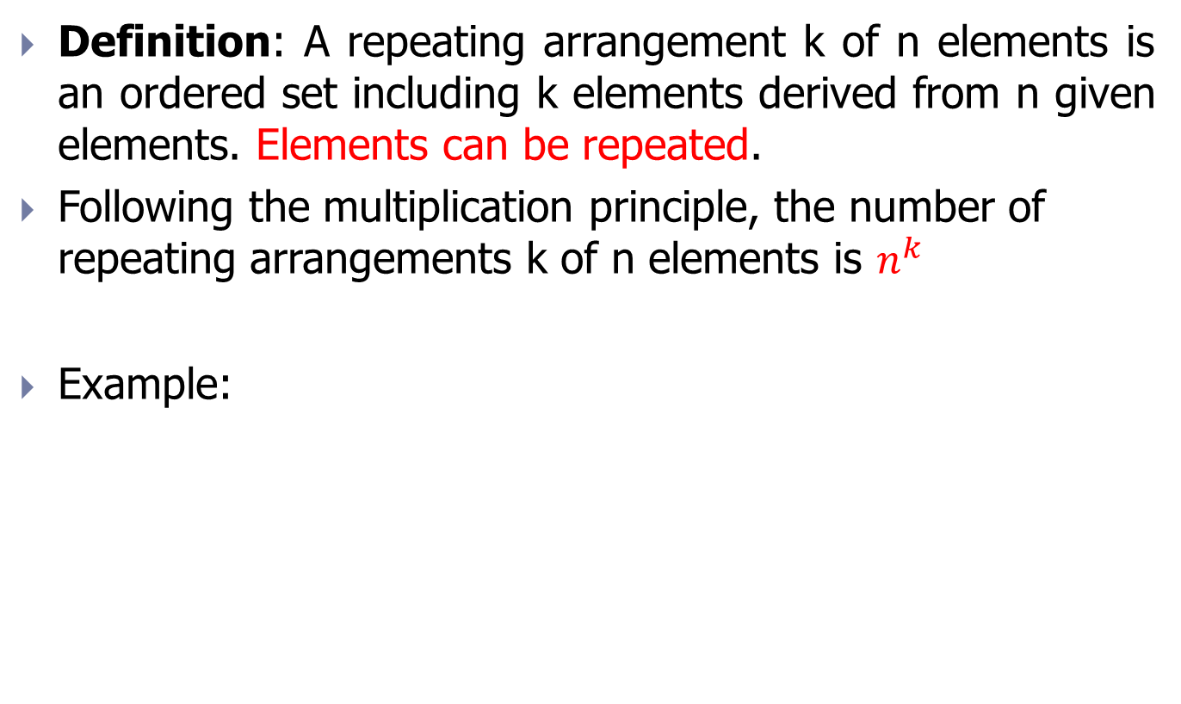
Repeating arrangement
Definition: A repeating arrangement k of n elements is an ordered set including k elements derived from n given elements. Elements can be repeated.
Following the multiplication principle, the number of repeating arrangements k of n elements is $n^{k}$
Example:

Slide 11
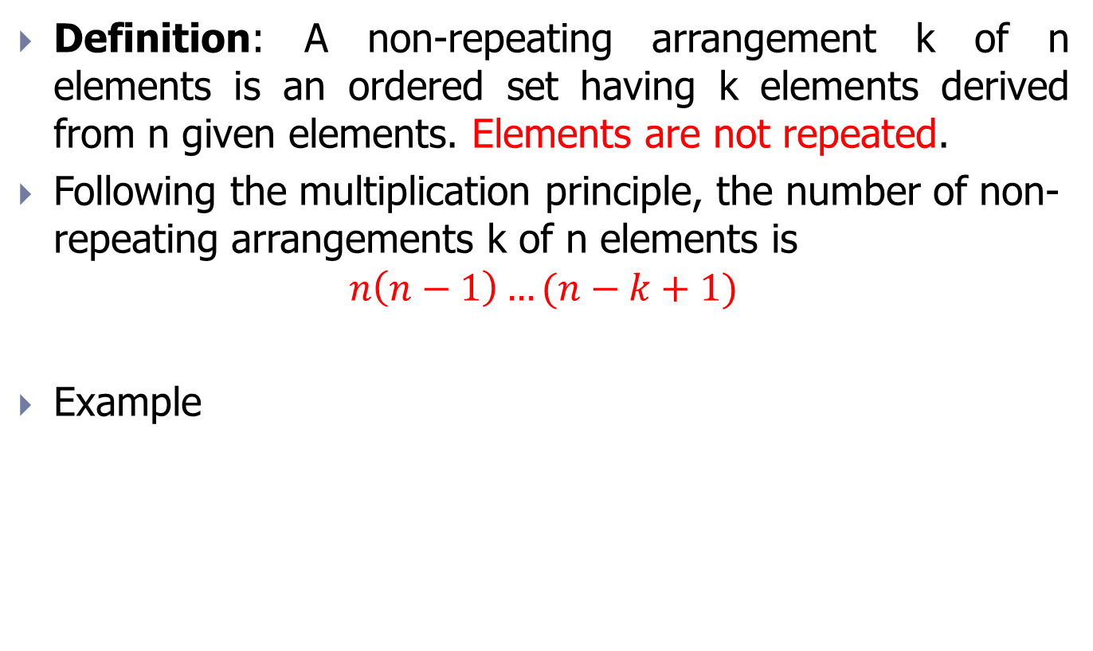
Non-repeating arrangement
Definition: A non-repeating arrangement k of n elements is an ordered set having k elements derived from n given elements. Elements are not repeated.
Following the multiplication principle, the number of non-repeating arrangements k of n elements is
$$n\left(n−1\right)…(n−k+1)$$
Example

Slide 12
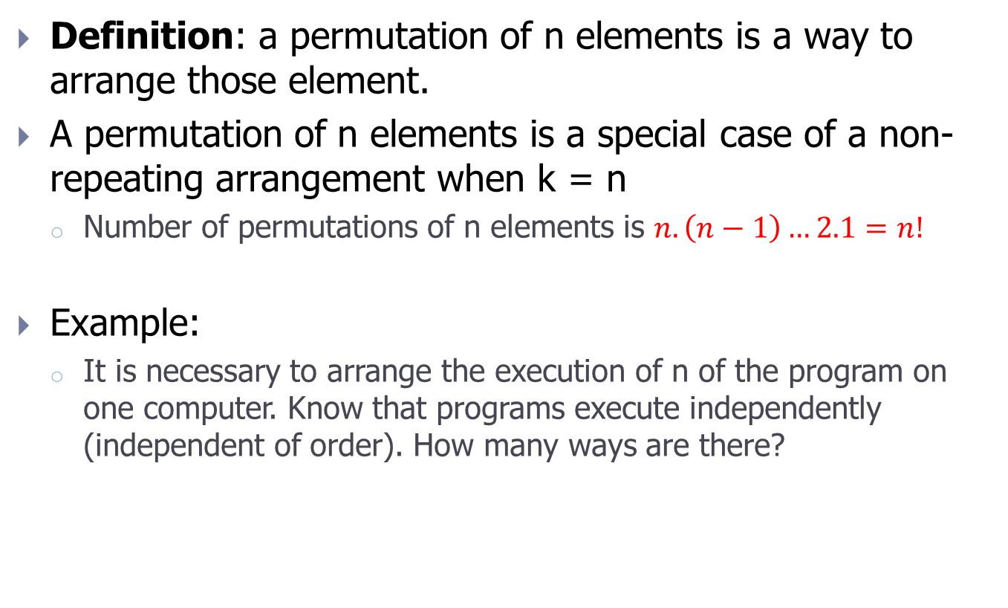
Permutation
Definition: a permutation of n elements is a way to arrange those element.
A permutation of n elements is a special case of a non-repeating arrangement when k = n
Number of permutations of n elements is $n.\left(n−1\right)…2.1=n!$
Example:
It is necessary to arrange the execution of n of the program on one computer. Know that programs execute independently (independent of order). How many ways are there?

Slide 13
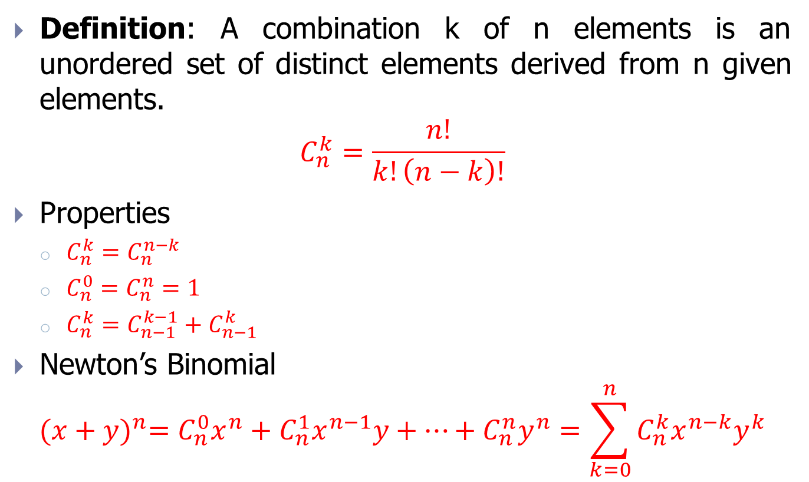
Combination
Definition: A combination k of n elements is an unordered set of distinct elements derived from n given elements.
$$C_{n}^{k}=\frac{n!}{k!\left(n−k\right)!}$$
Properties
$C_{n}^{k}=C_{n}^{n−k}$
$C_{n}^{0}=C_{n}^{n}=1$
$C_{n}^{k}=C_{n−1}^{k−1}+C_{n−1}^{k}$
Newton’s Binomial
$${(x+y)}^{n}=C_{n}^{0}x^{n}+C_{n}^{1}x^{n−1}y+…+C_{n}^{n}y^{n}=\sum_{k=0}^{n}{C_{n}^{k}x^{n−k}y^{k}}$$

Slide 14
Exercise 1
Using definition to prove some set operations

Slide 15
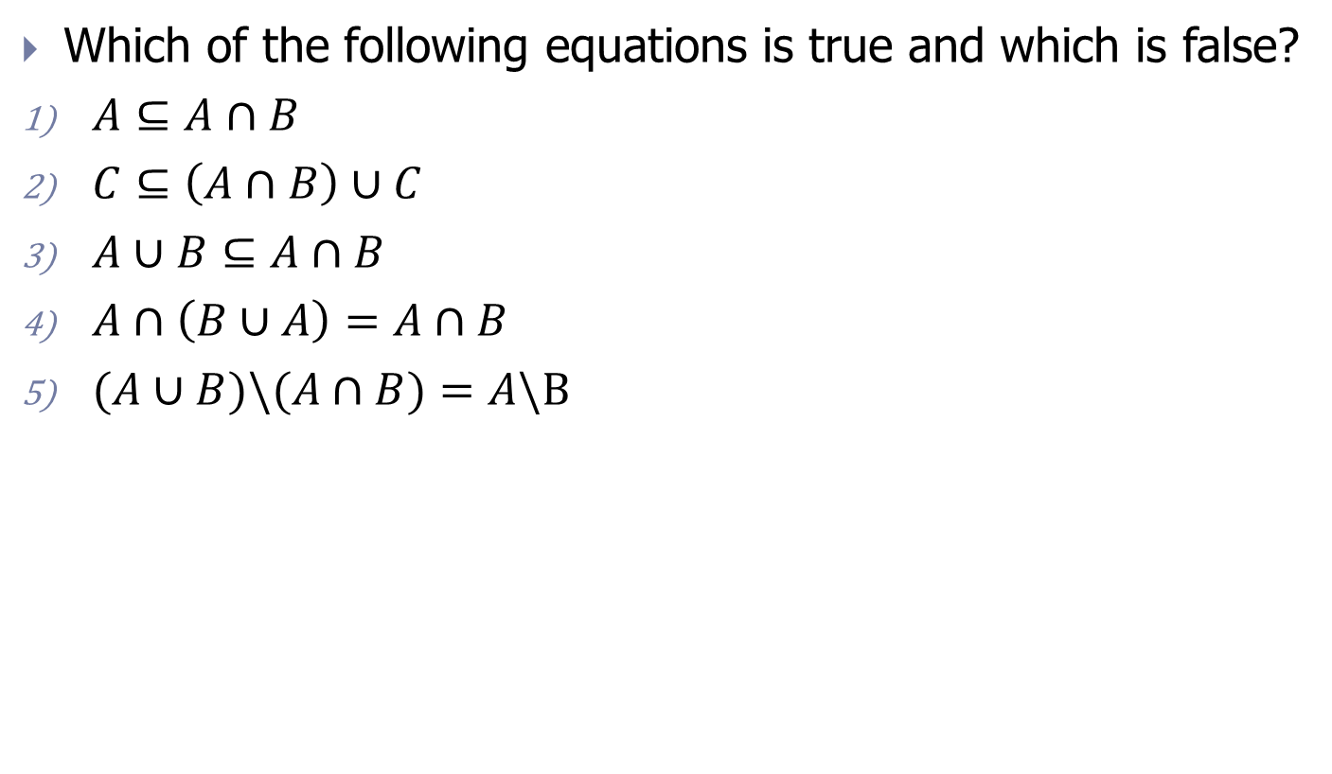
Exercise 2
Which of the following equations is true and which is false?
$A⊆A∩B$
$C⊆\left(A∩B\right)∪C$
$A∪B⊆A∩B$
$A∩\left(B∪A\right)=A∩B$
$(A∪B)\backslash (A∩B)=A\backslash B$

Slide 16

Exercise 3
The symbol Z is the set of integers. Consider 2 subsets of Z:
$$A=\left\{x∈Z:x=4p−1 with any p∈Z \right\}$$
$$B=\left\{y∈Z:y=4q+3 with any q∈Z\right\}$$
Prove that A = B.

Slide 17
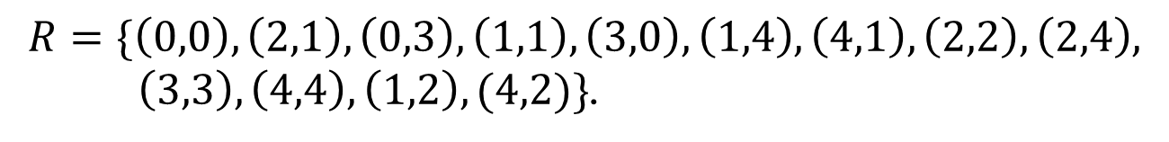
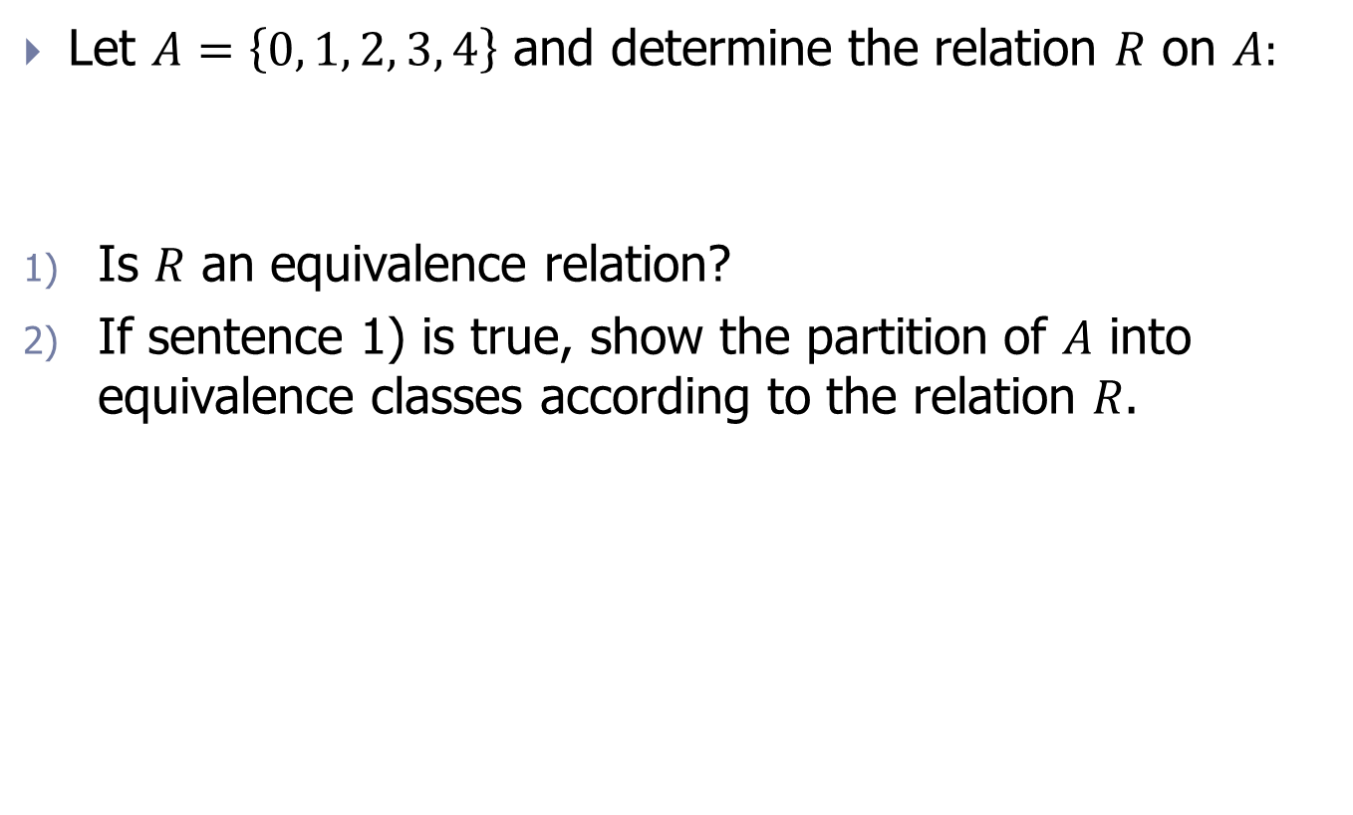
Exercise 4
Let $A=\left\{0, 1, 2, 3, 4\right\}$ and determine the relation $R$ on $A:$
Is 𝑅 an equivalence relation?
If sentence 1) is true, show the partition of 𝐴 into equivalence classes according to the relation 𝑅.
$$R=\{\left(0,0\right), \left(2,1\right), \left(0,3\right), \left(1,1\right), \left(3,0\right),\left(1,4\right),\left(4,1\right),\left(2,2\right),\left(2,4\right),$$
$\left(3,3\right),\left(4,4\right),\left(1,2\right),(4,2)\}$.

Slide 18
Contents
Set theory
Propositional logic
Algorithms and complexity
Exercise

Slide 19
Some definitions of propositional logic
Proposition or Clause: is an affirmative sentence that is either true or false.
Example:
“Hanoi is the capital city of Vietnam” is a true clause.
“(5 < 3)” is a false clause, “(5 > 3)” is a true clause.
“(a < 7)” is not a clause because it can not confirm whether this clause is true or not
The truth value of the proposition: Each proposition has only one of 2 values “True”, denoted by “T” and “False”, denoted by “F”. The set {T, F} is called the truth value of the proposition.
Notation: we denote the proposition with lowercase letters (a, b, p, q, r, s, t). A clause is also known as a formula. From the definition of proposition, the truth value of each proposition, we build complex propositions (called formula) through operations on propositions.

Slide 20

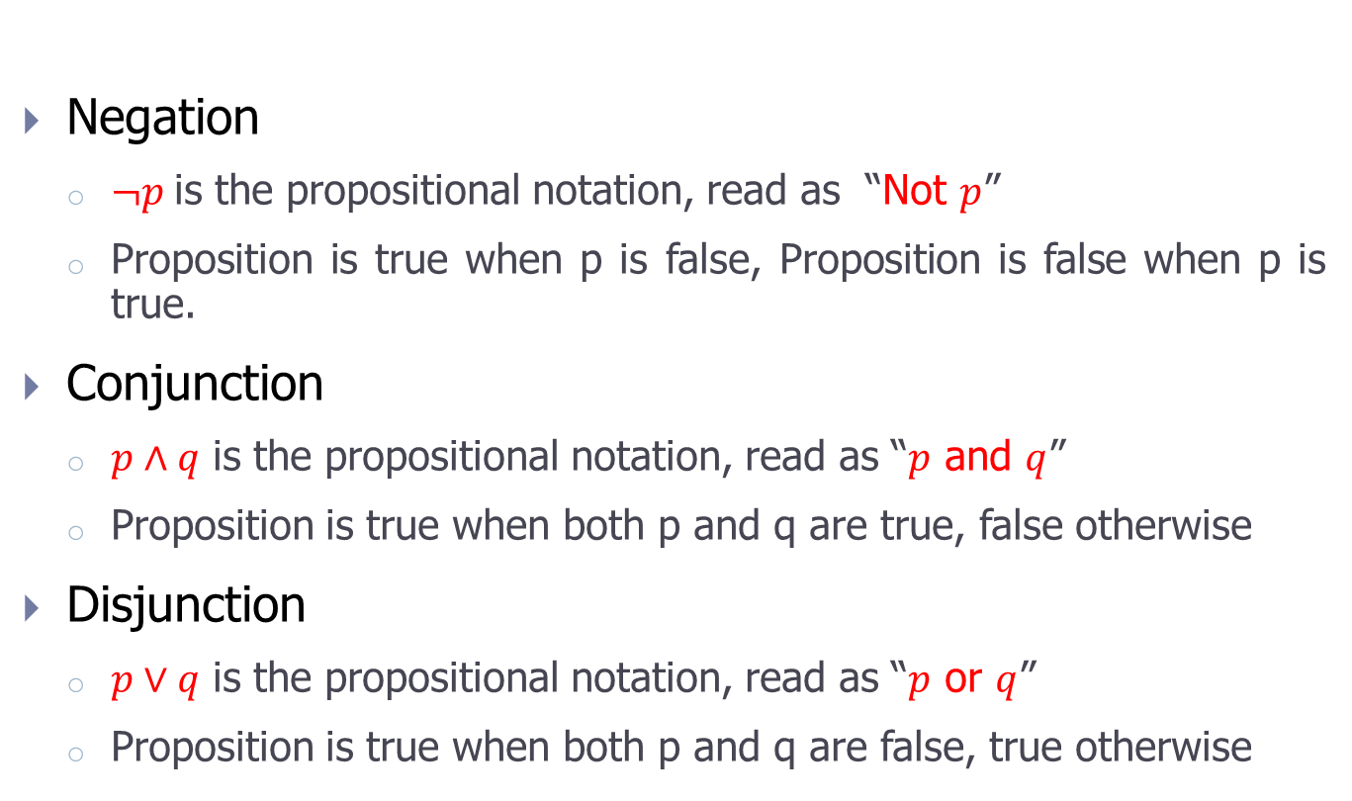
Mathematical operations of propositional logic (1/2)
Negation
$¬p$is the propositional notation, read as “Not $p$”
Proposition is true when p is false, Proposition is false when p is true.
Conjunction
$p∧q$ is the propositional notation, read as “$p$ and $q$”
Proposition is true when both p and q are true, false otherwise
Disjunction
$p∨q$ is the propositional notation, read as “$p$ or $q$”
Proposition is true when both p and q are false, true otherwise
Let $p$ and $q$ be 2 propositions

Slide 21
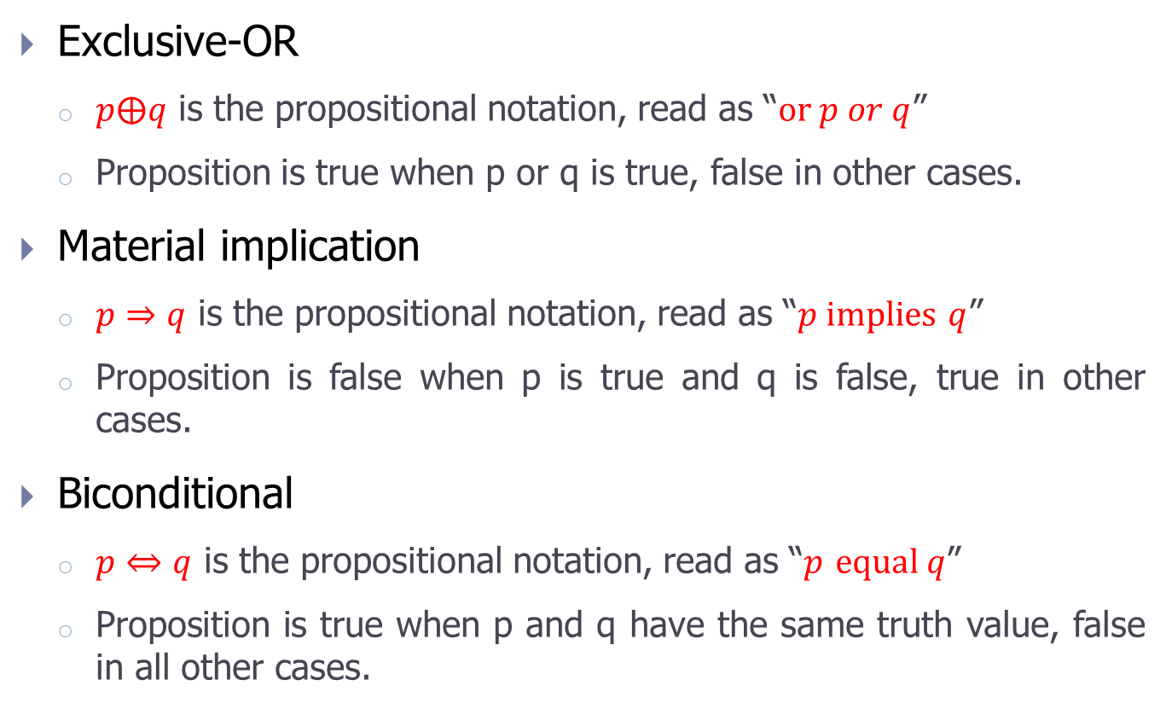
Mathematical operations of propositional logic (2/2)
Exclusive-OR
$p⨁q$ is the propositional notation, read as “$or p or q$”
Proposition is true when p or q is true, false in other cases.
Material implication
$p⇒q$ is the propositional notation, read as “$p implies$ $q$”
Proposition is false when p is true and q is false, true in other cases.
Biconditional
$p⇔q$ is the propositional notation, read as “$p$ $equal q$”
Proposition is true when p and q have the same truth value, false in all other cases.

Slide 22
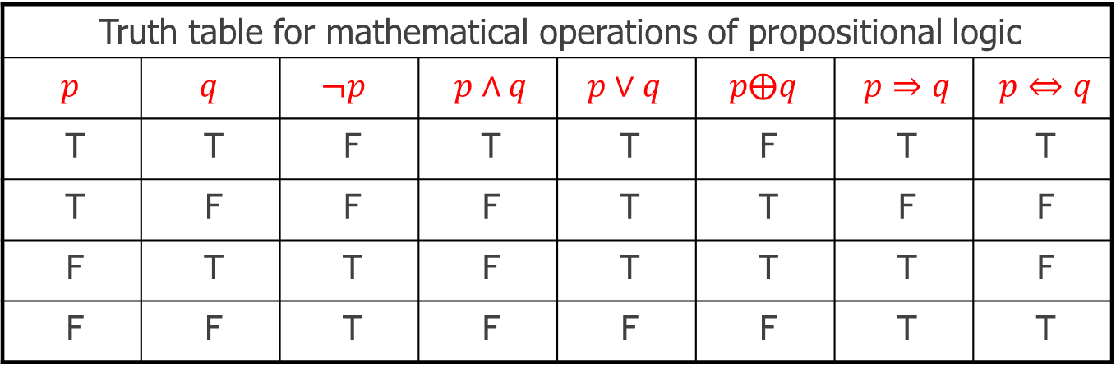
Truth table
Truth table for mathematical operations of propositional logic
$$p$$ | $$q$$ | $$¬p$$ | $p∧q$ | $$p∨q$$ | $$p⨁q$$ | $p⇒q$ | $p⇔q$
T | T | F | T | T | F | T | T
T | F | F | F | T | T | F | F
F | T | T | F | T | T | T | F
F | F | T | F | F | F | T | T
Applied bit-level operations in the LT language
Giá trị của A | Giá trị của B | A and B | A or B | A xor B
A = 13 =1101 | B = 8=1000 | 1000 | 1101 | 0101

Slide 23
Some definitions
Satisfiable
A proposition is satisfiable if it is true for a truth-value tuple of component propositions.
Unsatisfiable
A proposition is unsatisfiable if it is false for all truth value tuples of its component propositions.
Valid
A proposition is valid if it is true for all truth value tuples of its component propositions

Slide 24
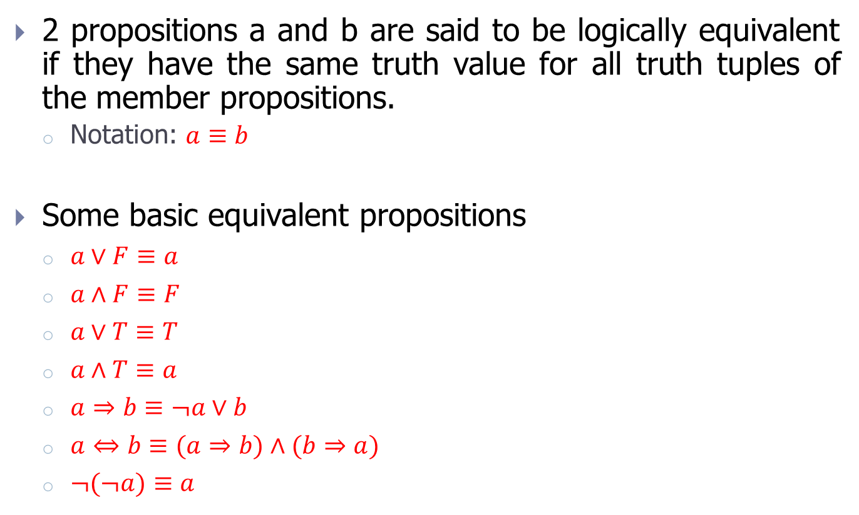
Logically equivalent propositions (1/2)
2 propositions a and b are said to be logically equivalent if they have the same truth value for all truth tuples of the member propositions.
Notation: $a≡b$
Some basic equivalent propositions
$a∨F≡a$
$a∧F≡F$
$a∨T≡T$
$a∧T≡a$
$a⇒b≡¬a∨b$
$a⇔b≡(a⇒b)∧(b⇒a)$
$¬(¬a)≡a$

Slide 25

Logically equivalent propositions (2/2)
Commutative laws
$a∨b≡b∨a$
$a∧b≡b∧a$
Associative laws
$\left(a∨b\right)∨c≡a∨\left(b∨c\right)$
$\left(a∧b\right)∧c≡a∧\left(b∧c\right)$
Distributive laws
$a∧\left(b∨c\right)≡$ $\left(a∧b\right)∨\left(a∧c\right)$
$a∨\left(b∧c\right)≡\left(a∨b\right)∧\left(a∨c\right)$
De Morgan’s laws
$¬(a∨b)≡¬a∧$ $¬b$
$¬(a∧b)≡¬a$ $∨$ $¬b$

Slide 26
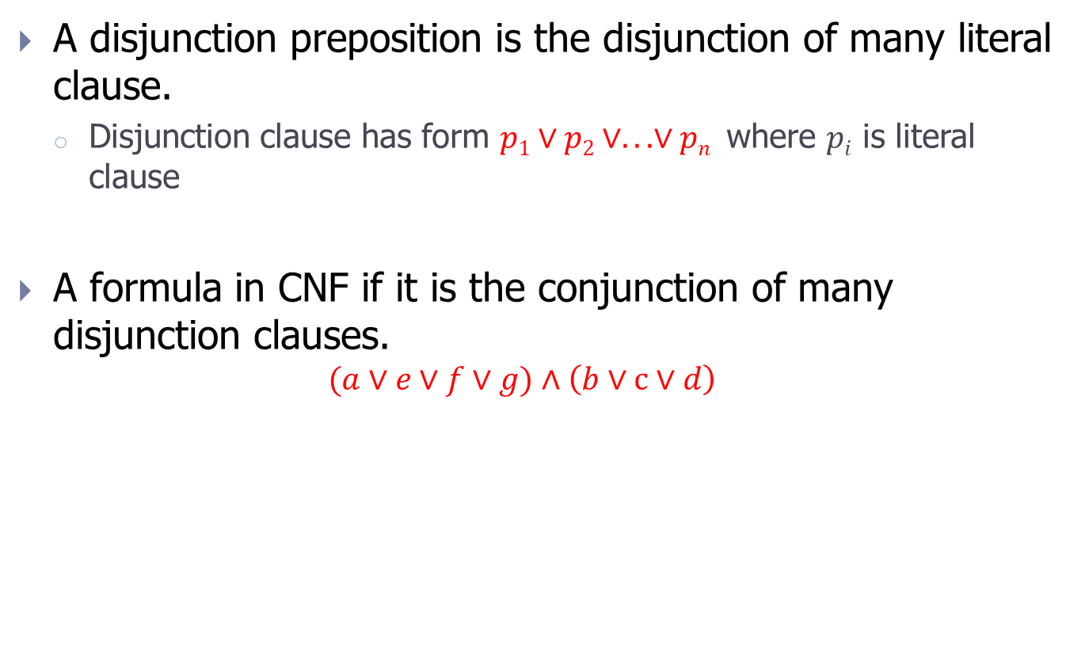
Conjunctive normal form - CNF(1/2)
A disjunction preposition is the disjunction of many literal clause.
Disjunction clause has form $p1∨p2∨...∨pn$ where $pi$ is literal clause
A formula in CNF if it is the conjunction of many disjunction clauses.
$$(a∨e∨f∨g)∧\left(b∨c∨d\right)$$

Slide 27
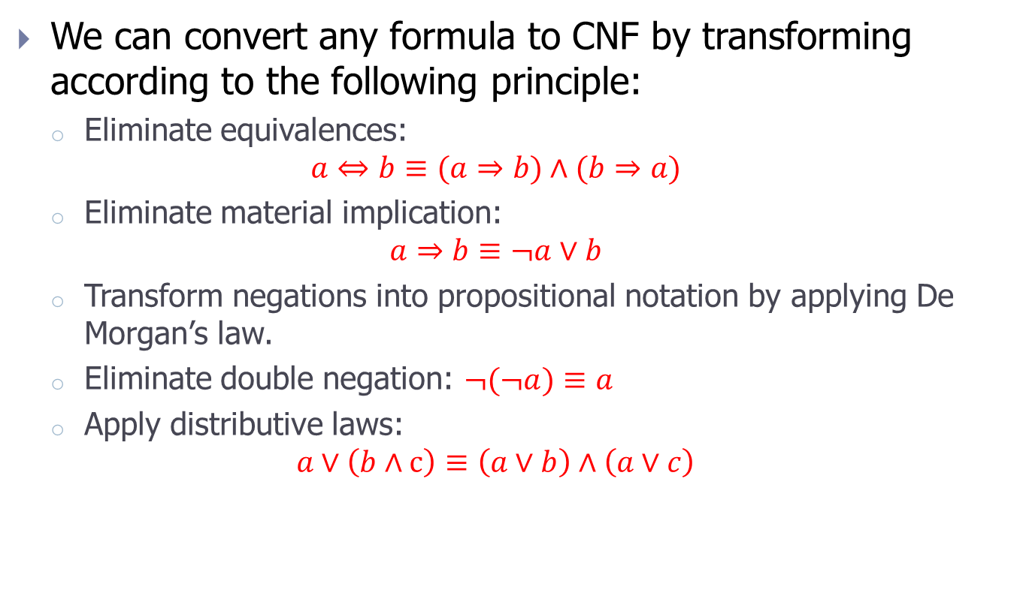
Conjunctive normal form – CNF (2/2)
We can convert any formula to CNF by transforming according to the following principle:
Eliminate equivalences:
$$a⇔b≡(a⇒b)∧(b⇒a)$$
Eliminate material implication:
$$a⇒b≡¬a∨b$$
Transform negations into propositional notation by applying De Morgan’s law.
Eliminate double negation: $¬(¬a)≡a$
Apply distributive laws:
$$a∨\left(b∧c\right)≡\left(a∨b\right)∧\left(a∨c\right)$$

Slide 28
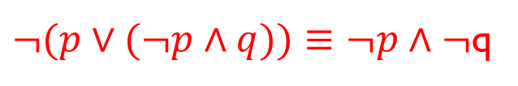
Exercise1
Using truth table method, prove the logical equivalences between propositions:
Basic equivalent propositions.
Laws.
Using basic equivalent propositions and laws (associative, commutative, distributive, De Morgan) prove the logical equivalence between propositions:
$¬(p∨(¬p∧q))≡¬p∧¬$q

Slide 29

Exercise 2
Prove following propositions are valid:
g) $¬p∧\left(p∨q\right)⇒q$
h) $(p⇒q)$ $∧\left(q⇒r\right)⇒\left(p⇒r\right)$
$(p∧$ $(p⇒q)$ ) $⇒q$
j) ($\left(p∨q\right)$ $∧$ $\left(p⇒r\right)$ $∧$ $\left(q⇒r\right))⇒r$

Slide 30
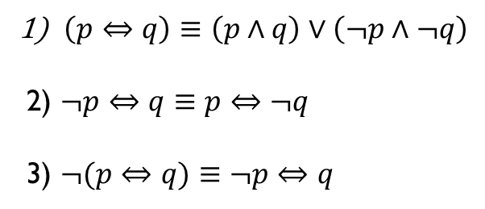
Exercise 3
Prove the following logical equivalences:
$\left(p⇔q\right)≡\left(p∧q\right)∨\left(¬p∧¬q\right)$
2) $¬p⇔q≡$ $p⇔¬q$
3) $¬(p⇔q)≡$ $¬p⇔q$

Slide 31

Exercise 4
Convert to CNF:
$$(p⇒q)∨¬(r∨¬s)$$

Slide 32
Contents
Set theory
Propositional logic
Algorithms and complexity
Exercise

Slide 33
Definition of algorithm
Algorithm
A procedure that solves a problem in a finite number of steps
A finite set of well-defined instructions to solve a problem
A set of rules that define exactly a sequence of actions
Algorithm description
Use natural language
Use Pseudo-code
Use programming language

Slide 34
Algorithm example(1/2)
Algorithm: Find the largest integer in a list of integers (unsorted)
Description of algorithms using natural language
If there is no number in the list then there is no greatest number.
Assume the first number is the largest number in the list.
For each remaining number in the list, if this number is greater than the current largest number, then consider this number the largest number.
When all numbers in the list have been considered, the current largest number is result.
Complicated, rarely

Slide 35
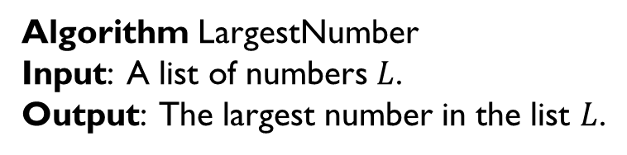
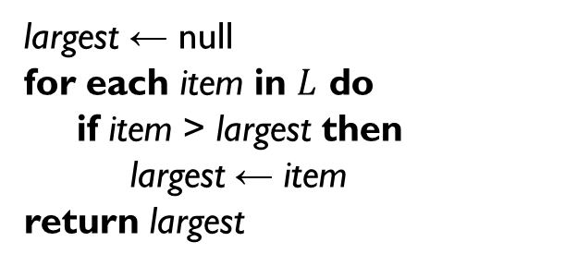
Algorithm example (2/2)
Algorithm: Find the largest integer in a list of integers (unsorted)
Describe the algorithm using Pseudo code
Algorithm LargestNumber
Input: A list of numbers $L$.
Output: The largest number in the list $L$.
largest ← null
for each item in $L$ do
if item > largest then
largest ← item
return largest
Easy to understand, easy to use,
not depend on the programming language

Slide 36
Complexity of algorithms
Most algorithms are designed to work with arbitrary size of input data
For example, the algorithm on the previous page, the input data size is the number of elements in the list (n).
Time complexity
Determine the amount of time required to execute the algorithm
Calculated as the number of operations to perform the algorithm
Space complexity
Determine the amount of memory required to execute the algorithm
Maximum amount of memory required to store objects of the algorithm at a time of algorithm execution
Usually described as a function of the input data size

Slide 37
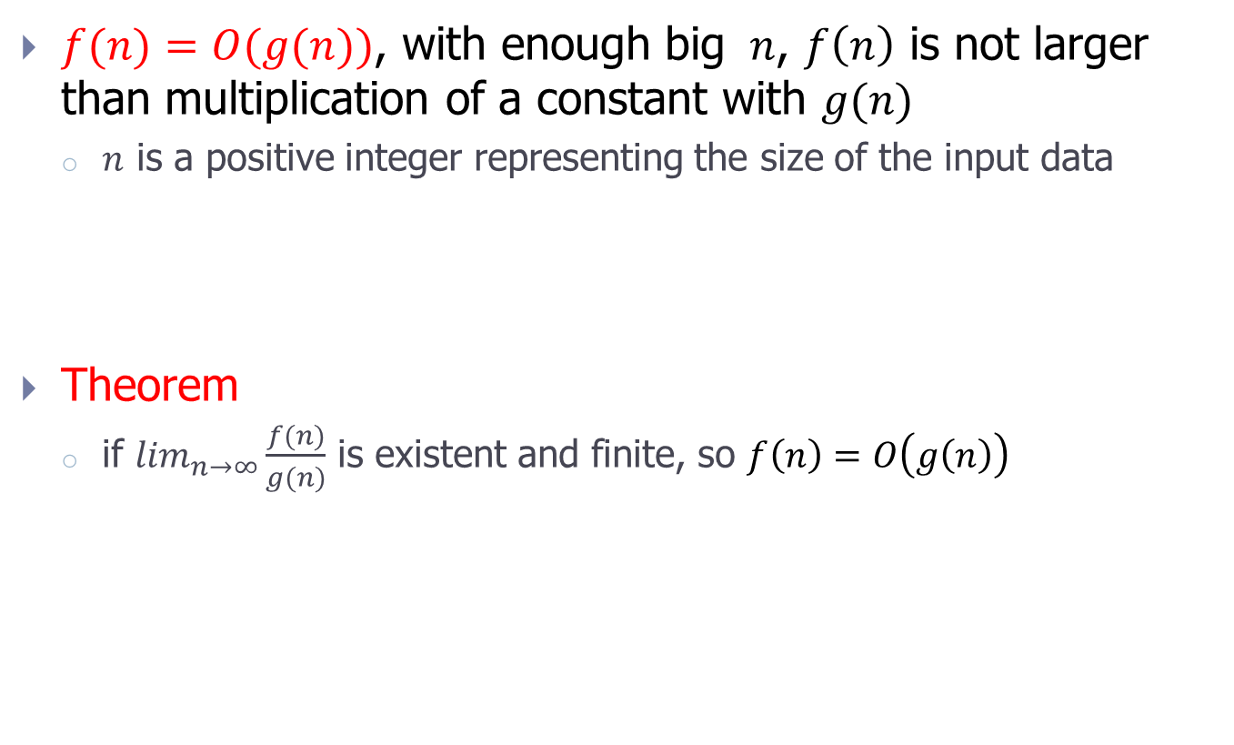
Definition of Big-O
$f(n)=O(g(n))$, with enough big $n$, $f\left(n\right)$ is not larger than multiplication of a constant with $g(n)$
$n$ is a positive integer representing the size of the input data
Theorem
if $\lim_{n→∞}\frac{f(n)}{g(n)}$ is existent and finite, so $f\left(n\right)=O\left(g\left(n\right)\right)$
$$f\left(n\right)=O\left(g\left(n\right)\right)⇔∃c,n_{0}.∀n≥n_{0}, f\left(n\right)≤c∗g(n).$$

Slide 38
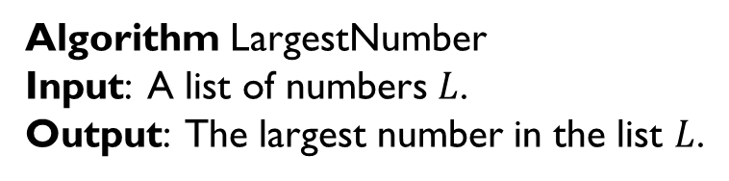
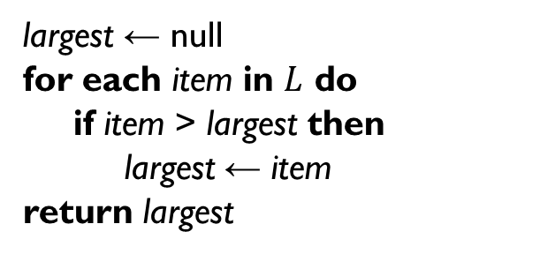
Example
Algorithm: Find the largest integer in a list of integers
Algorithm LargestNumber
Input: A list of numbers $L$.
Output: The largest number in the list $L$.
largest ← null
for each item in $L$ do
if item > largest then
largest ← item
return largest
Both time and space complexity are O(n)

Slide 39
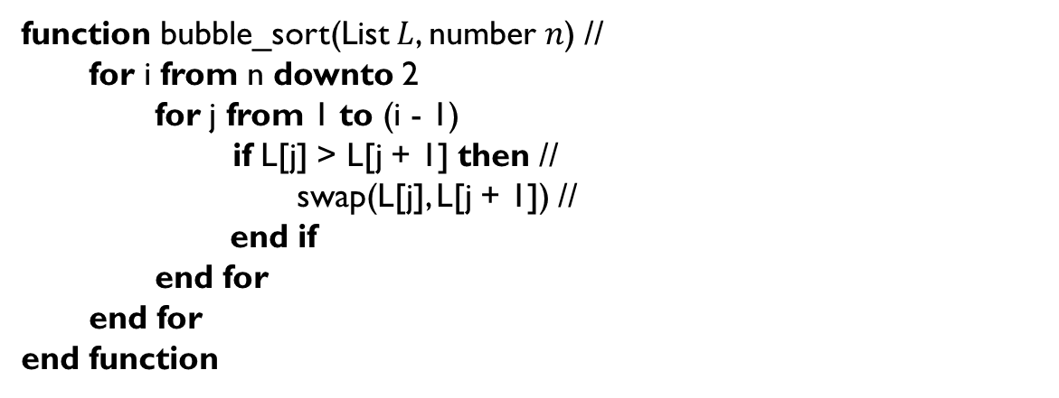
Exercise 1
Find the complexity of bubble sort algorithm
function bubble_sort(List $L$, number $n$) //
for i from n downto 2
for j from 1 to (i - 1)
if L[j] > L[j + 1] then //
swap(L[j], L[j + 1]) //
end if
end for
end for
end function

Slide 40

Exercise 2
Find the complexity of binary search algorithm in sorted list
function binary_search($A,x,L,R$)
if $L>R$then
return Fail
else
$i ← \left\lfloor (L + R)/2\right\rfloor$
if $A[i]==x$ then
return $i$
else if $A[i]>x$ then
return binary_search($A,x,L,i−1$)
else
return binary_search($A,x,i+1,R$)
end if
end if
end function

